Slide 1
Farmland ownership: what matters most?
Teresa Opheim, Practical Farmers
November 9, 2015
www.practicalfarmers.org

Slide 2
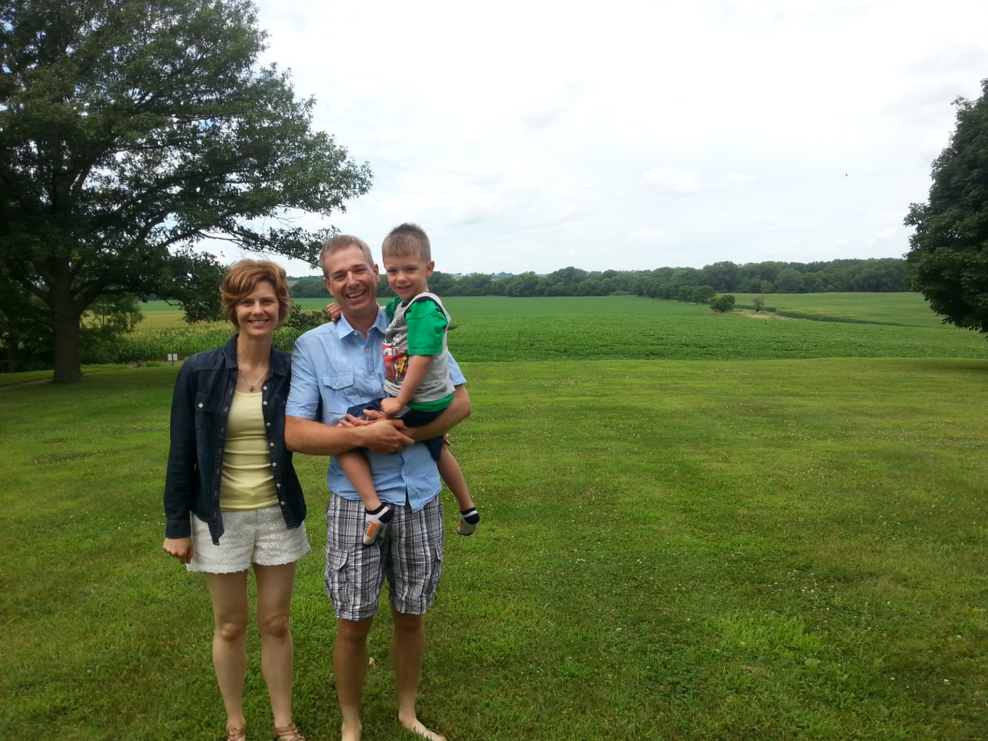
Beat your neighbor by a bushel?

Slide 3
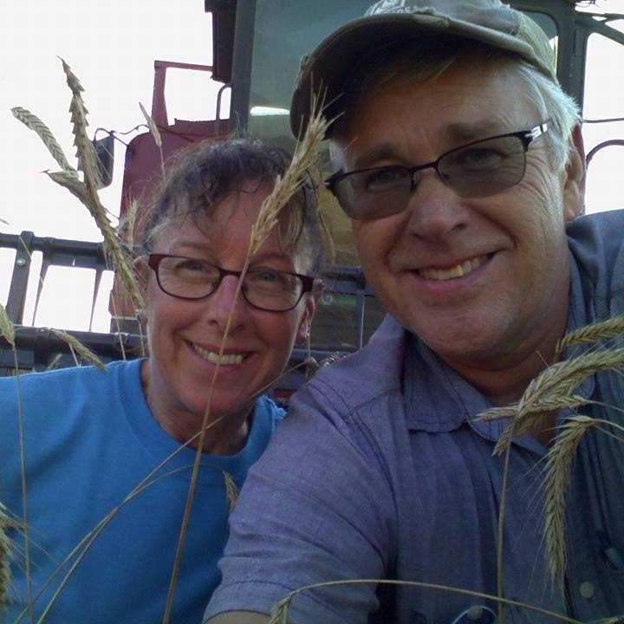
400+ leaders

Slide 4
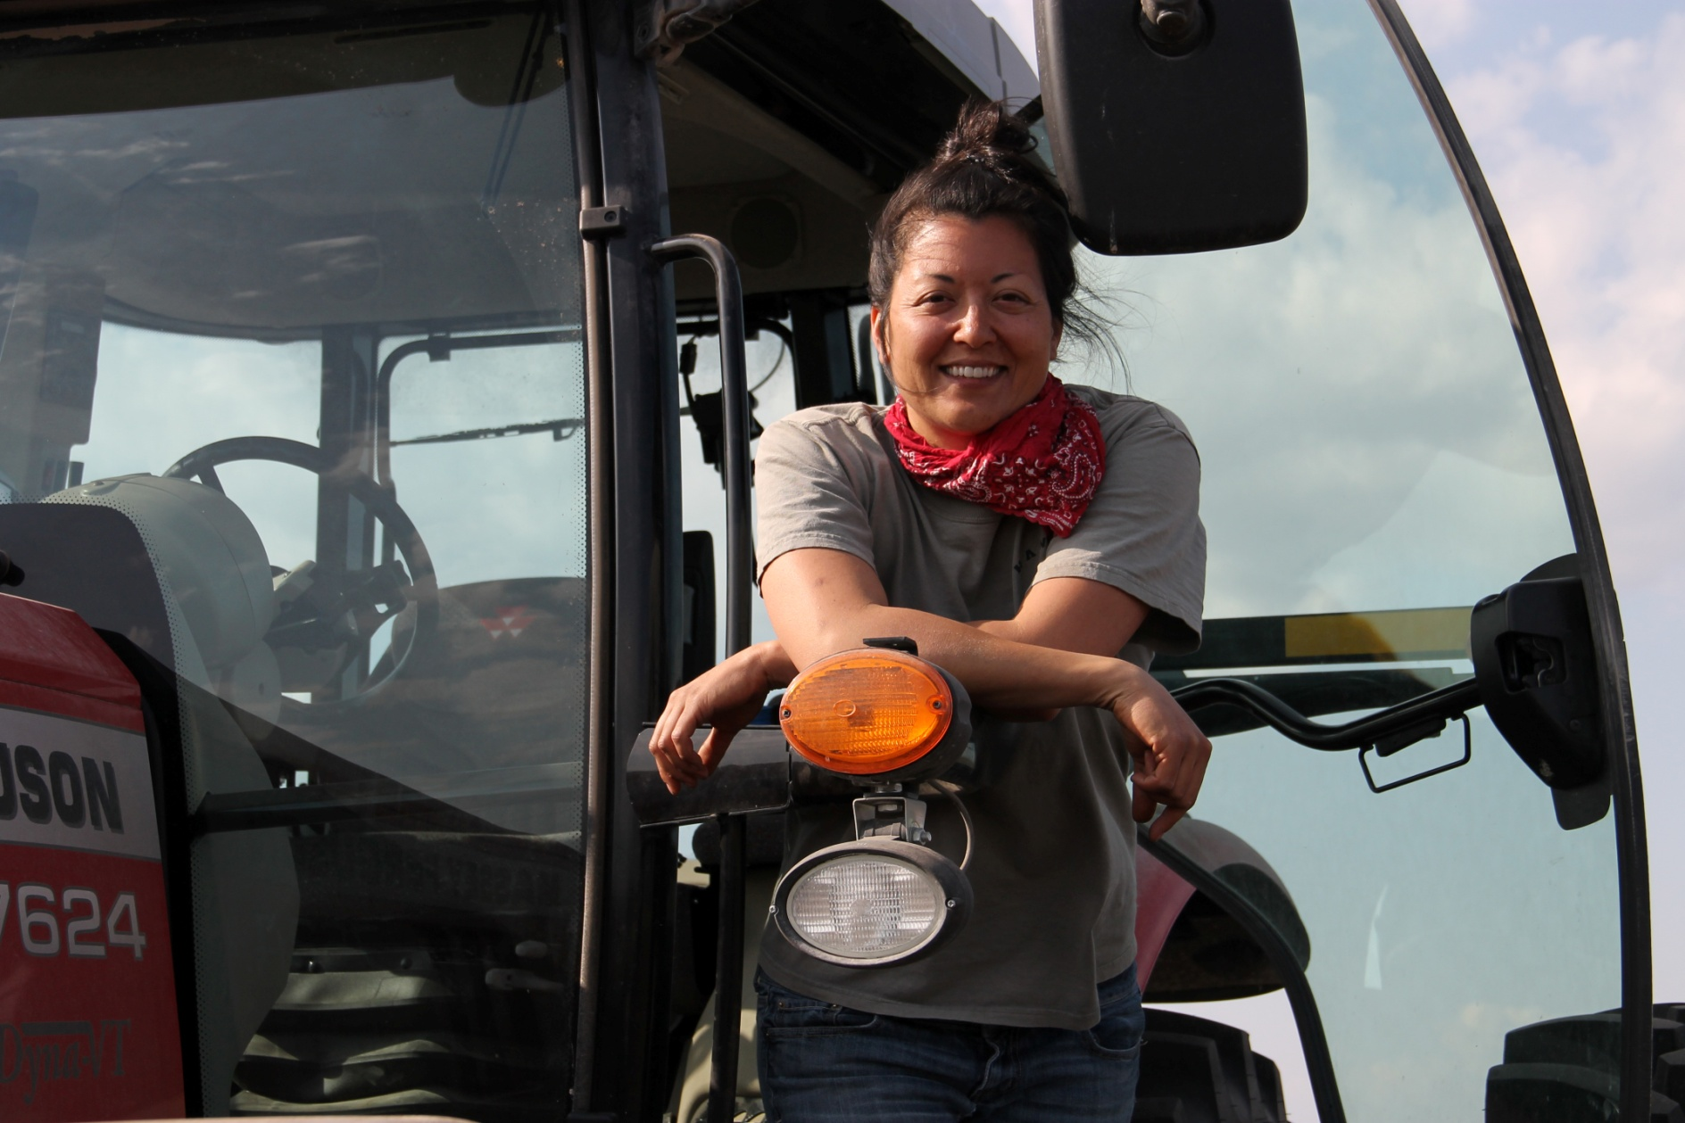
Many want to farm

Slide 5
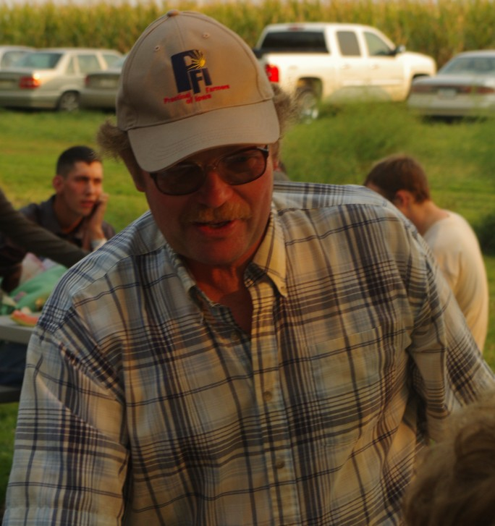
"I can't imagine farming in a state that didn't have a Practical Farmers group”
John Gilbert

Slide 6
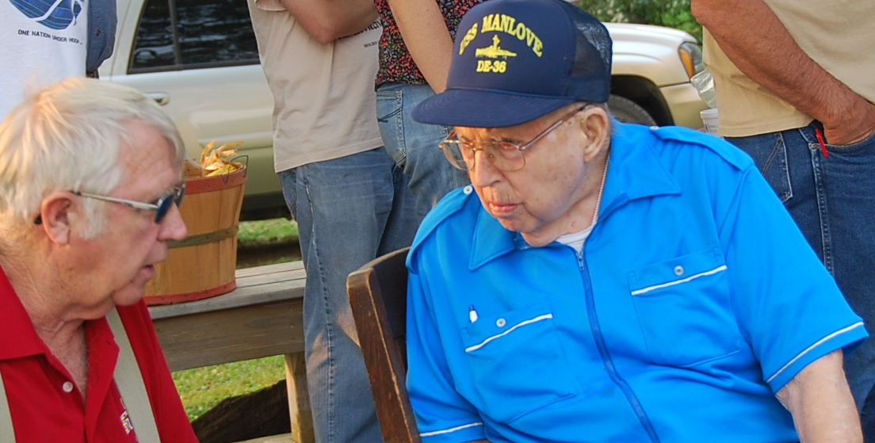
Barely a ripple in farm transition

Slide 7
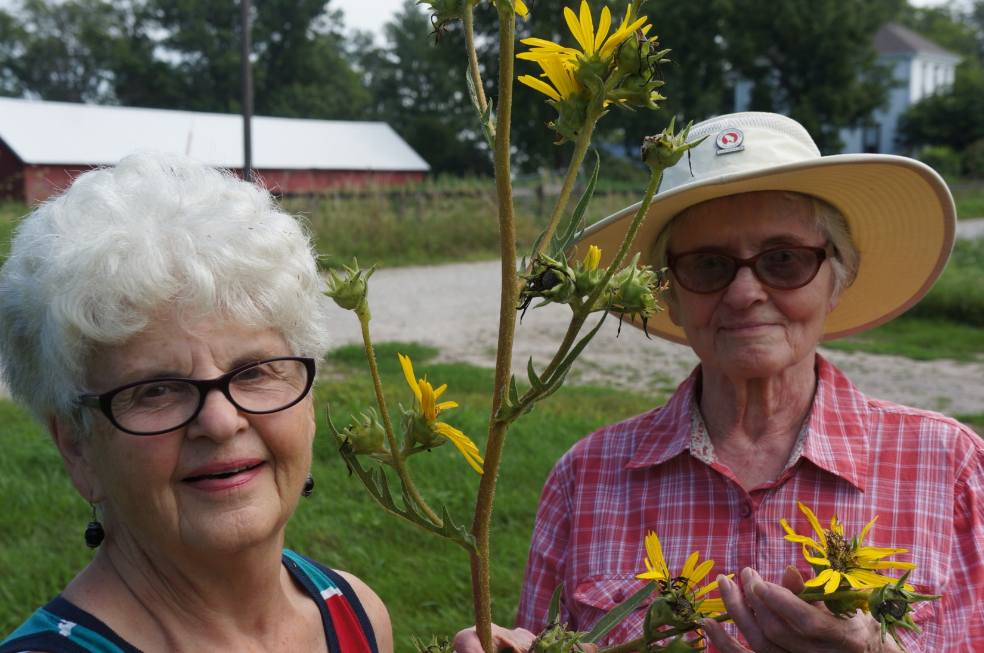
Aging landowners

Slide 8
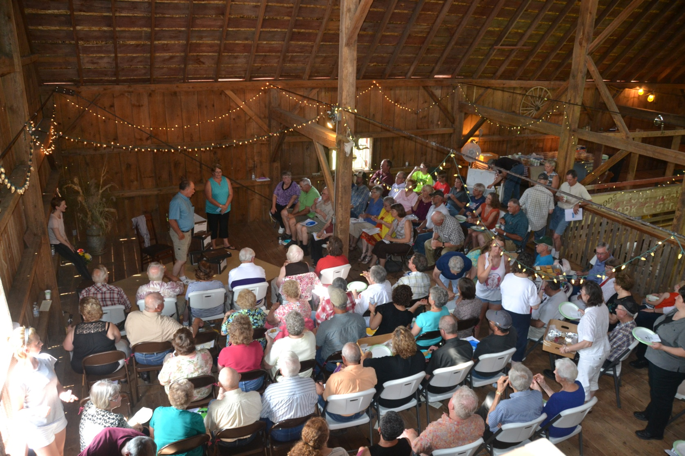
Map of my kingdom pic
Map of My Kingdom: A play about “who gets the land”

Slide 9
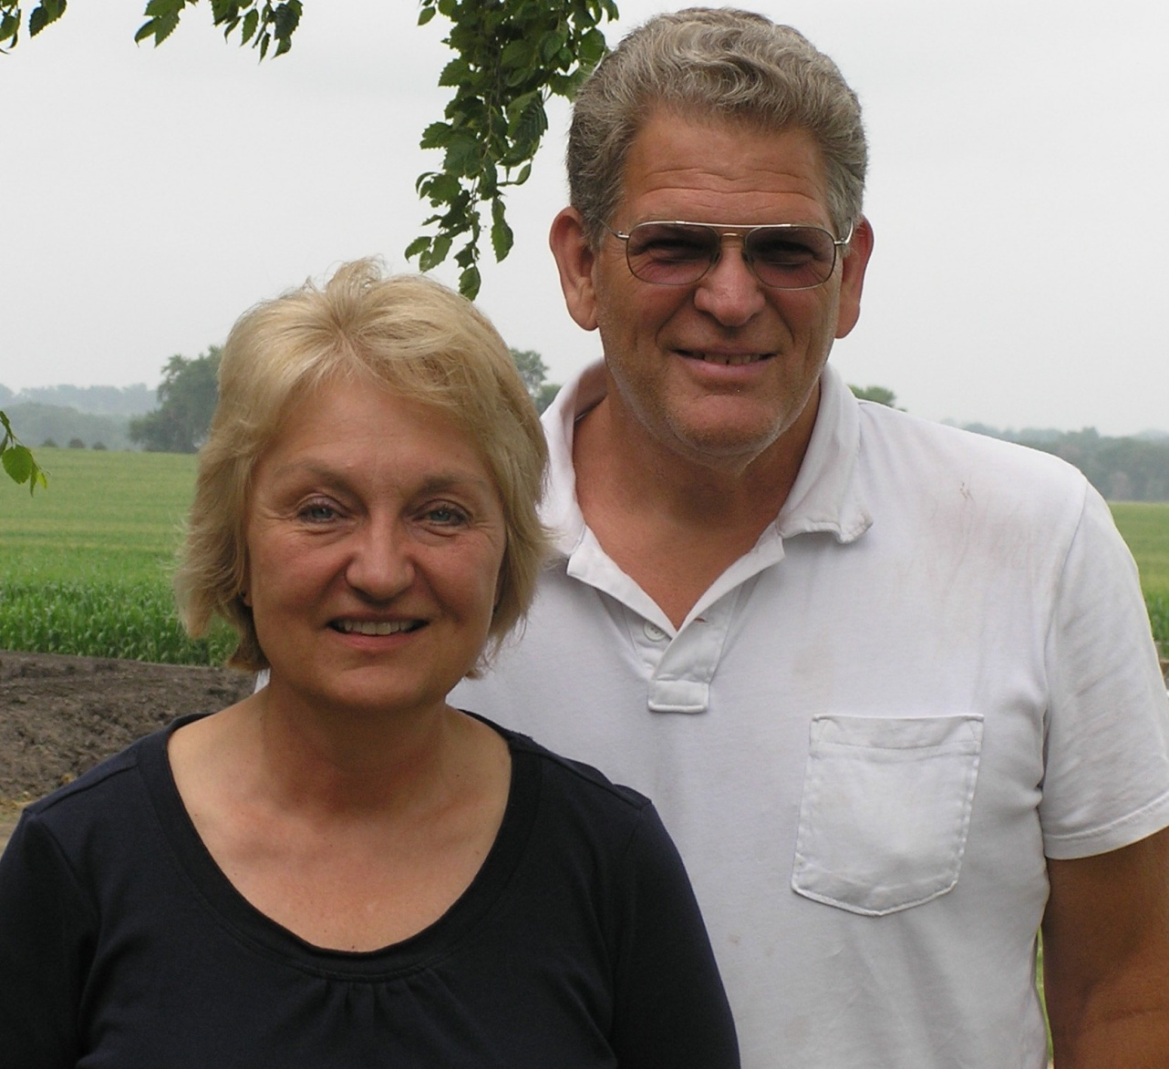
Strategy: farmland in trust

Slide 10
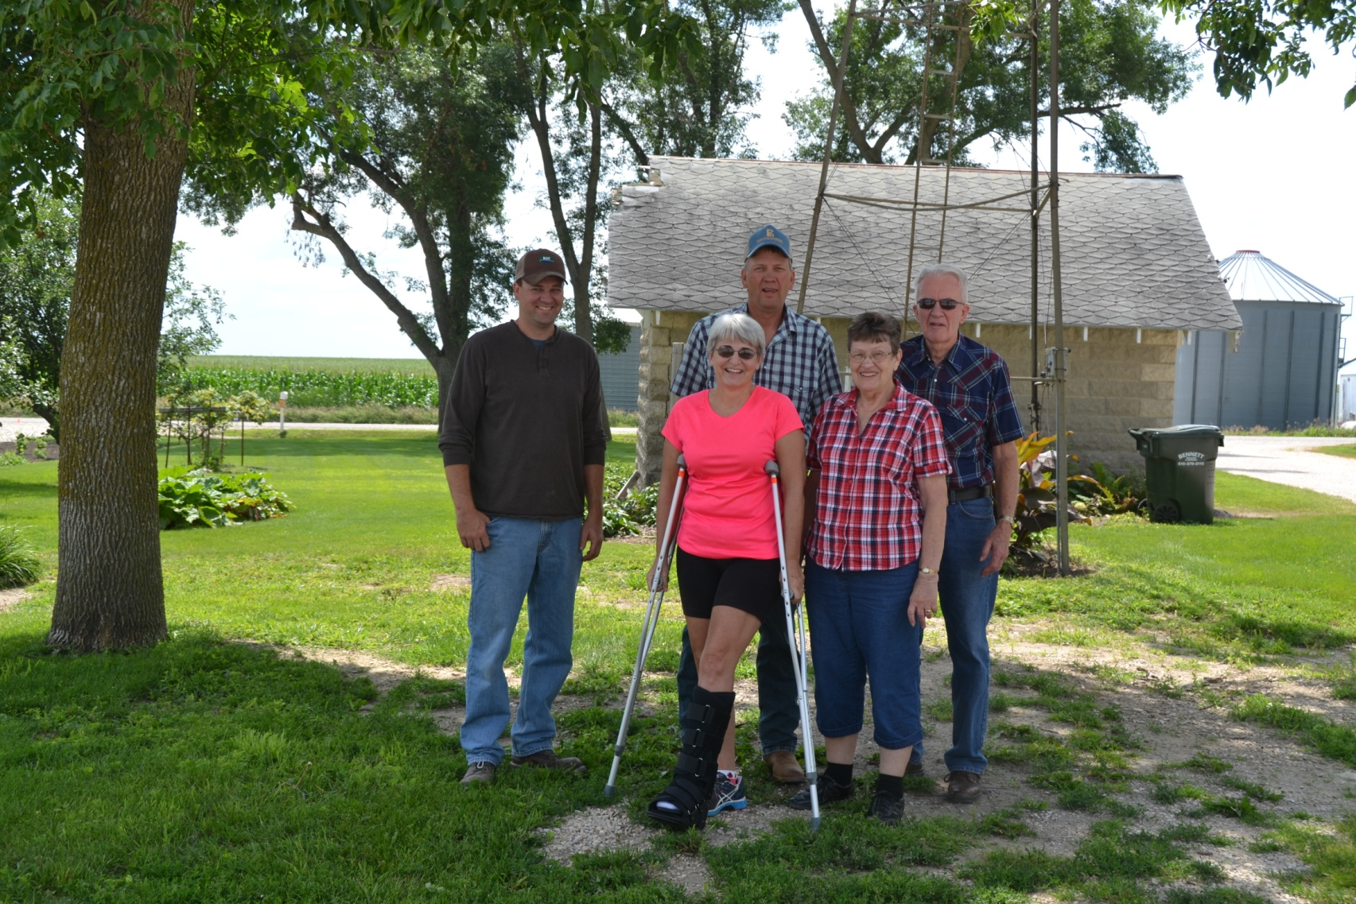
Strategy: gift land

Slide 11
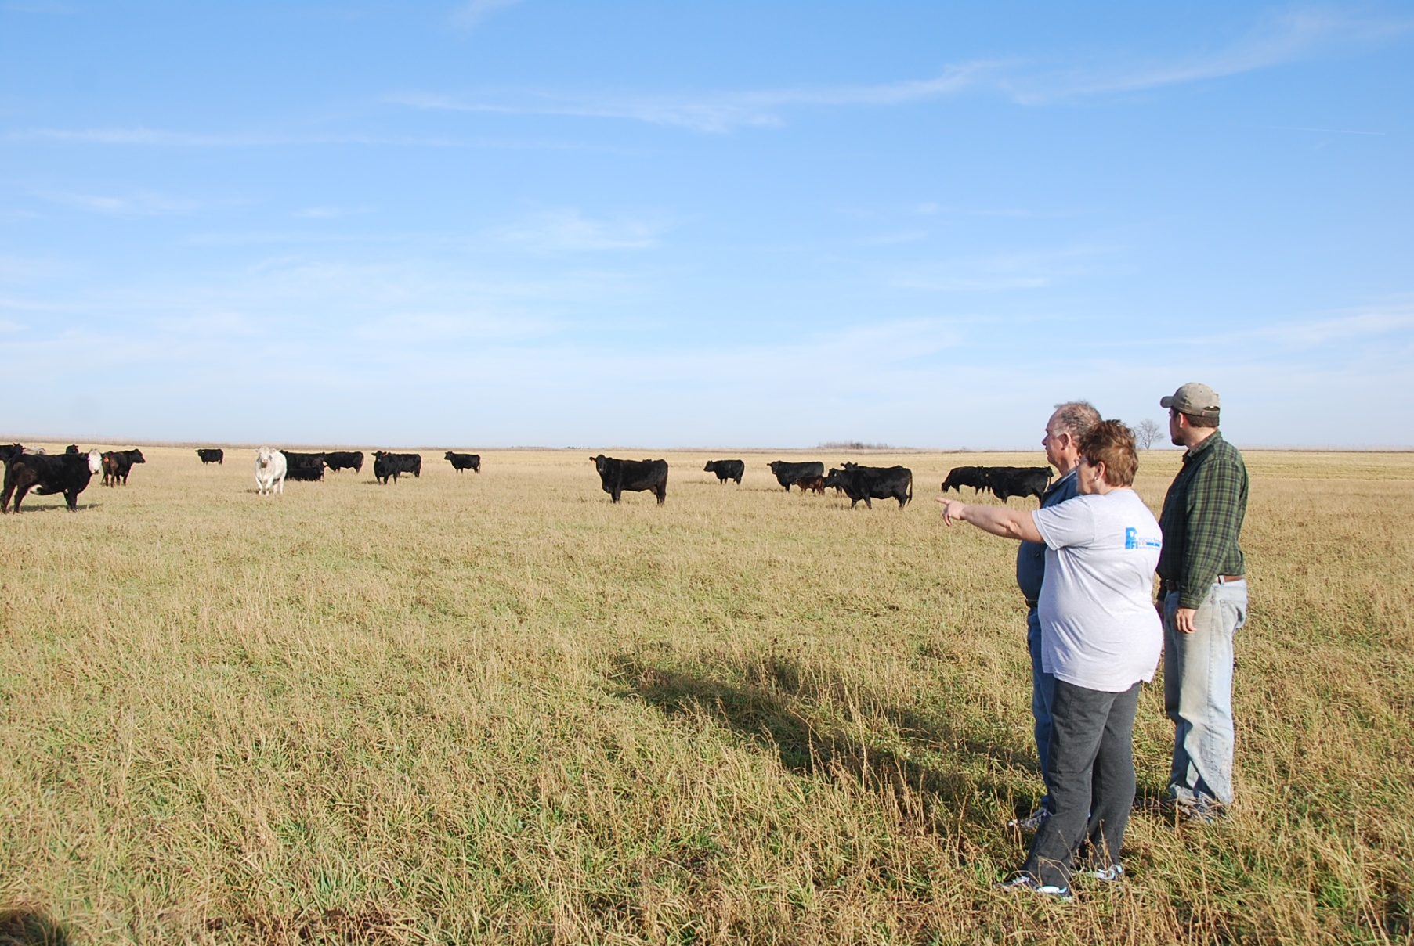
Strategy: life insurance

Slide 12
Whoa.
Slow down…
What matters most?

Slide 13
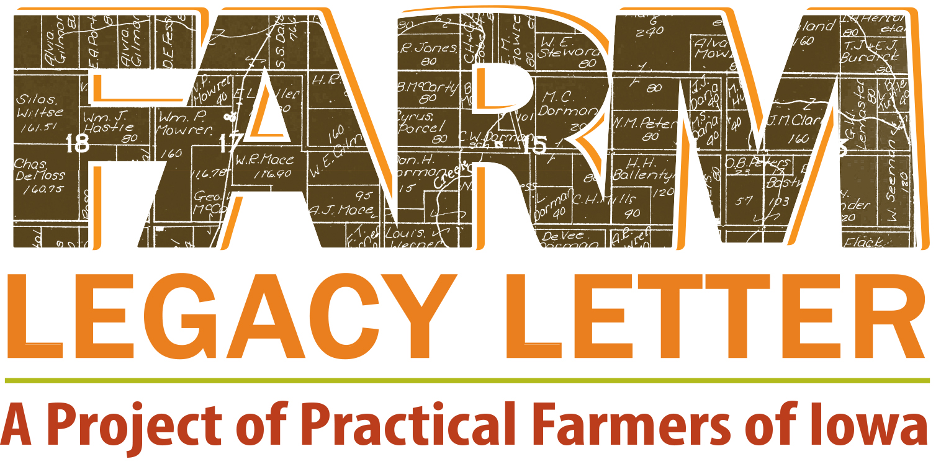

Slide 14
30 years out? Common goals
Provide land for my farming heir(s) to farm
Provide a farm for a family to work
Help provide my heirs with greater financial stability through the sale of, or rental income from, the farm
Use my farmland to benefit a charitable cause
Give all of my heirs an inheritance of equal economic value
Keep the farmland in my family
Use the farmland for conservation

Slide 15
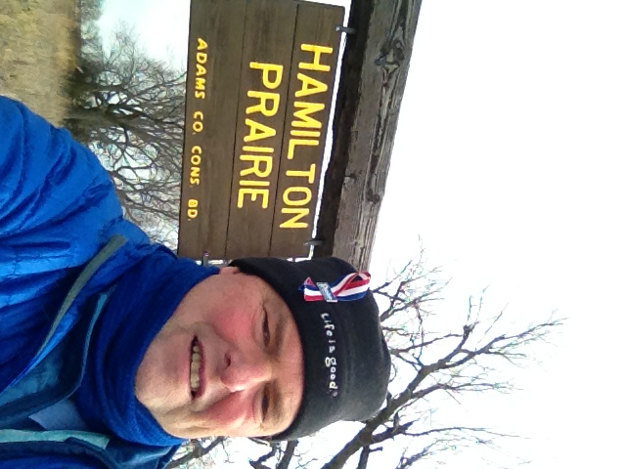
Goal: new farmers on the land

Slide 16
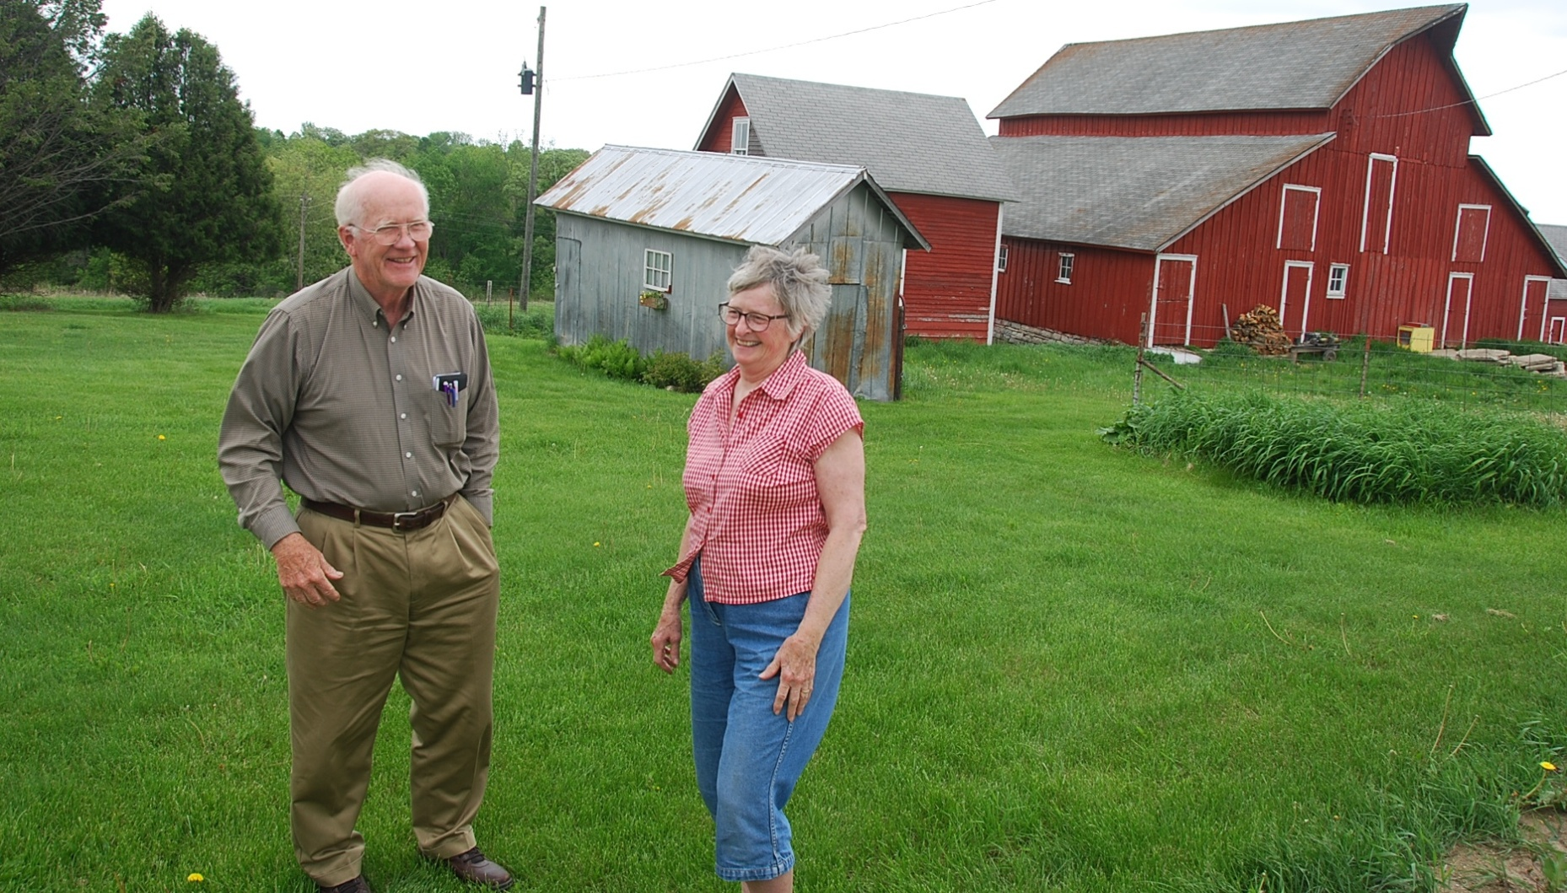
Goal: Give back to community
Notes:
This is a different goal than the previous one. This goal focuses on having people out there living on and working the land, whether those people are related to the farmland owner or not. Pictured here is Dale and Sunny Nimrod, and theirs is a wonderful story. Dale grew up near Stanton in far Southwest Iowa. His father died of a brain tumor when he was young, and the Stanton community helped his mother raise Dale and his siblings. He went on to become a professor at Luther College, and his sibilings didn’t want to farm either. “We were no different from many aging land owners,” Dale says. “We aspired to find a nice young family who would appreciate the land, the community and the church, and invest themselves in all three.” But rather than just putting their farmland up to the highest bid, they contacted the Lutheran pastor in Stanton and asked for names of those families interesting in farming. And he eventually sold on generous terms to Mark an Melanie Peterson, who now farm the land. That was the best way to give back to the community that had given to him.

Slide 17
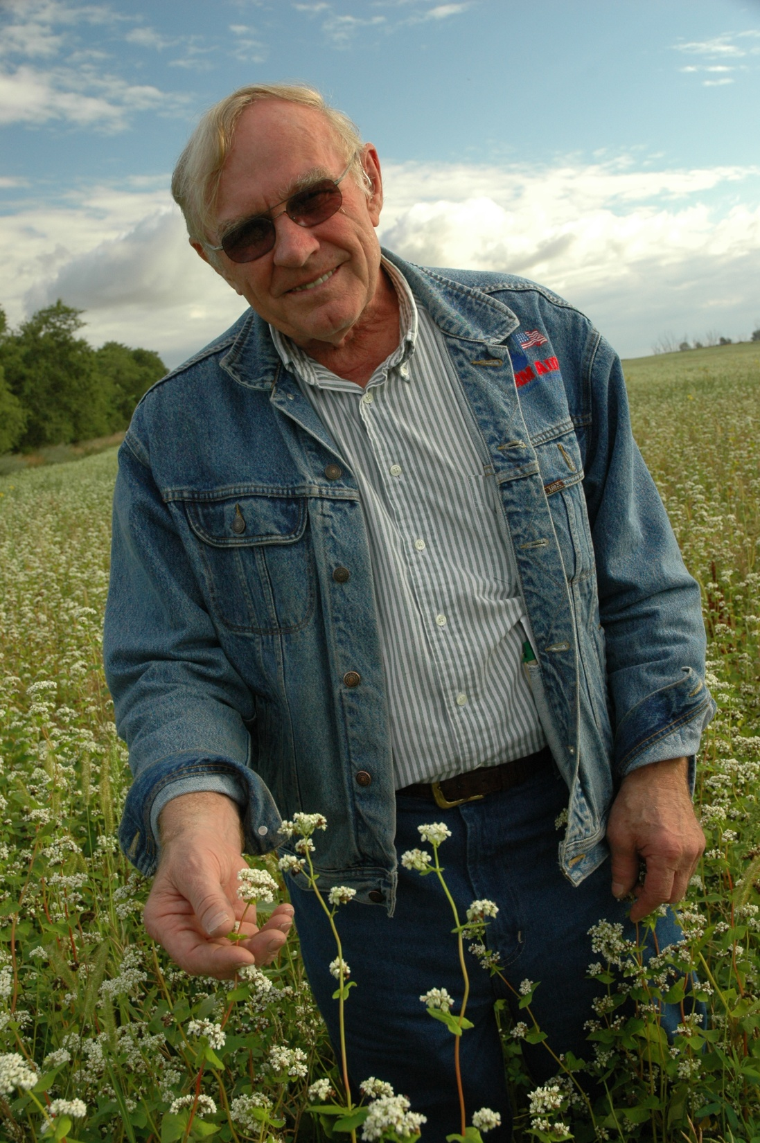
Goal: build soils, biodiversity

Slide 18
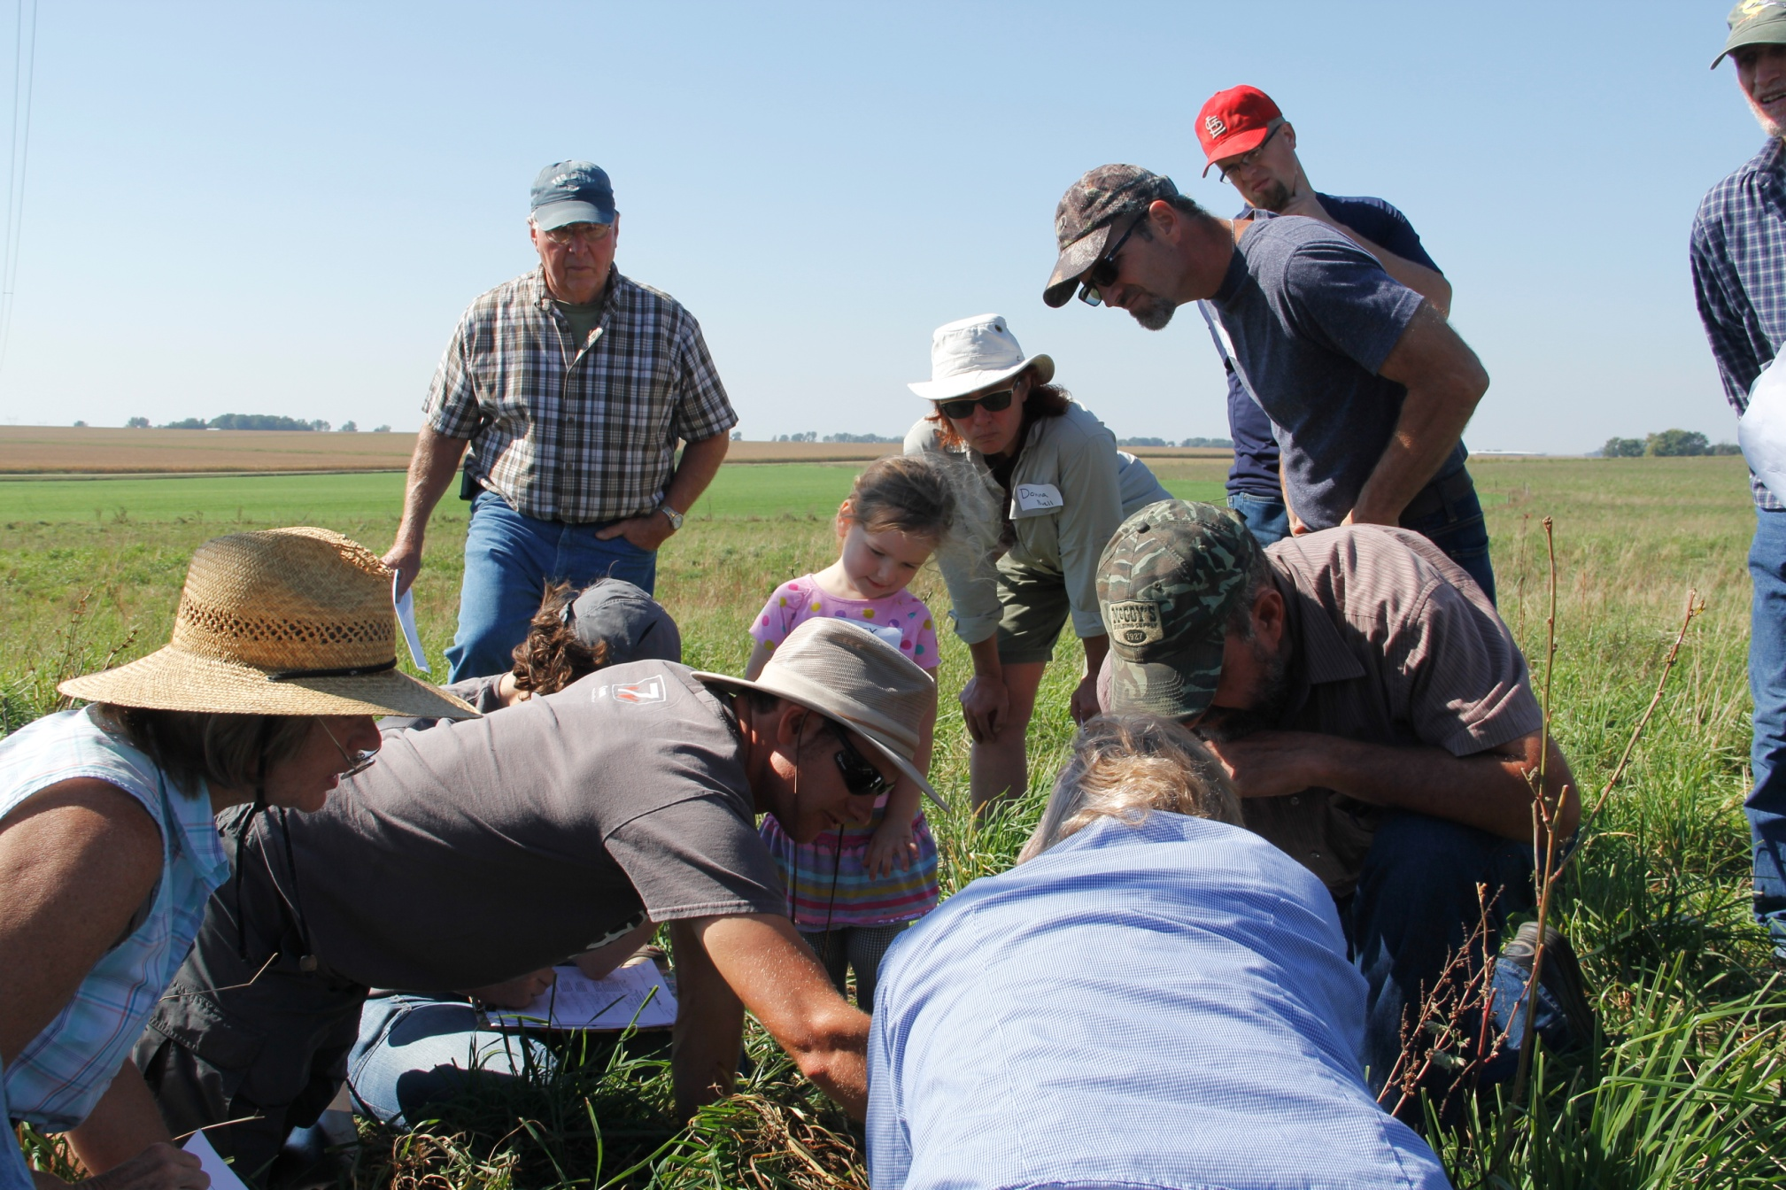
Keep farmland together? or farming heirs continue?
Was Mom’s top goal keep the farmland in the family…or allow her farming heirs to farm?
Did she want to treat each offspring financially equally? Or would she be open to some “sweat equity” compensation?

Slide 19
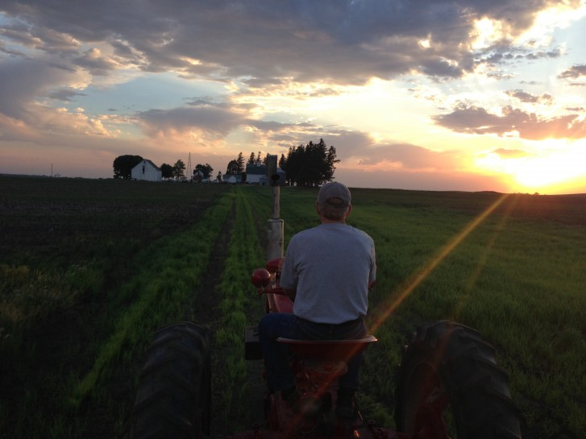
Equal shares? or farming heir continues?

Slide 20
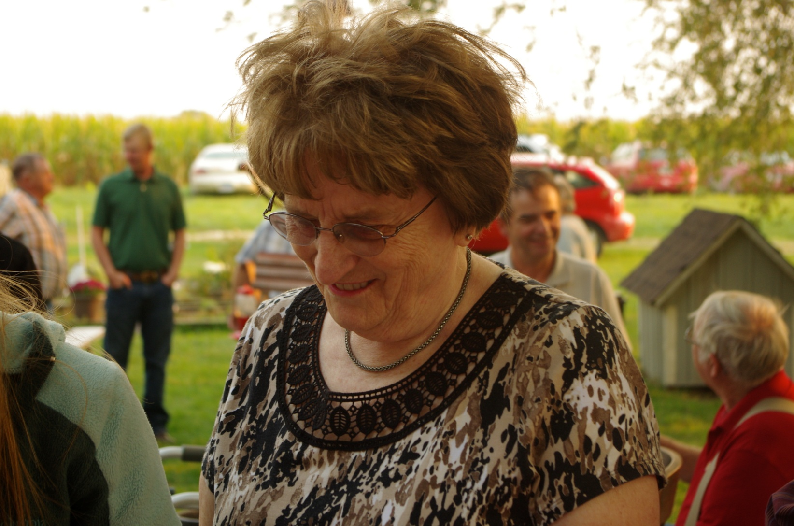
Keep family harmony

Slide 21
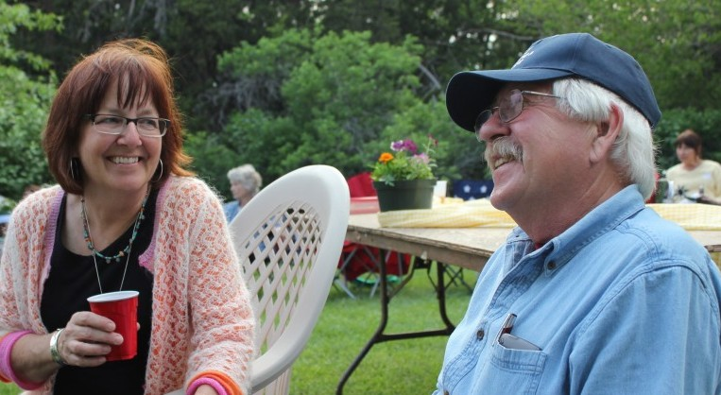
Know the past, vision for future

Slide 22
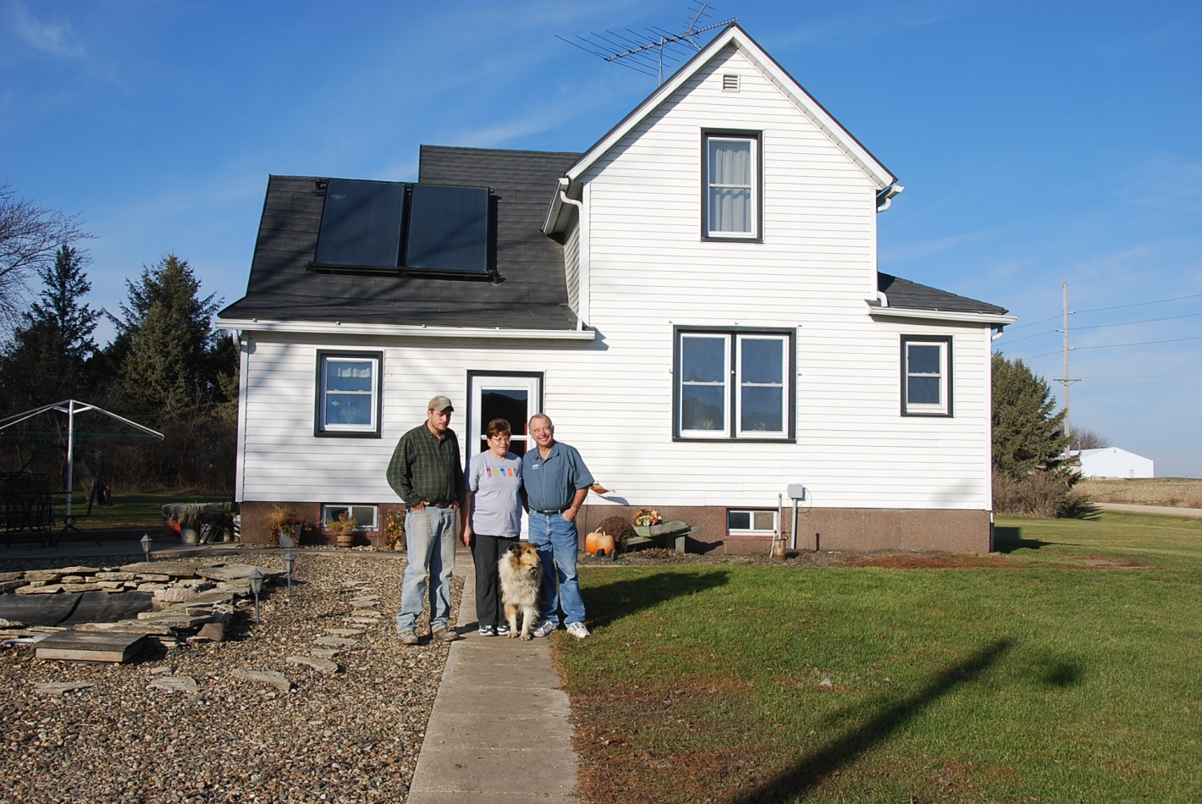
What will the farm be like when we’re gone?

Slide 23
thank you!
“We come and go, but the land is always here. And the people who love it and understand it, are the people who own it—for a little while.”
--Willa Cather, O Pioneers! repeated in Mary Swander, Map of My Kingdom

